Slide 1
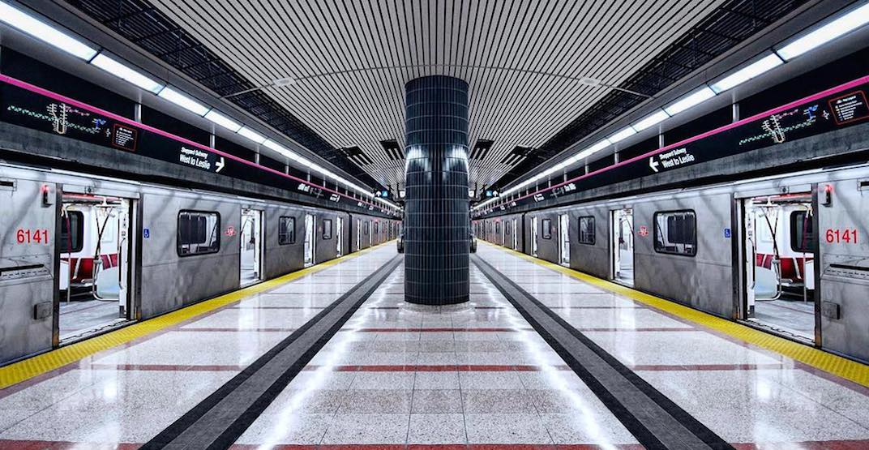
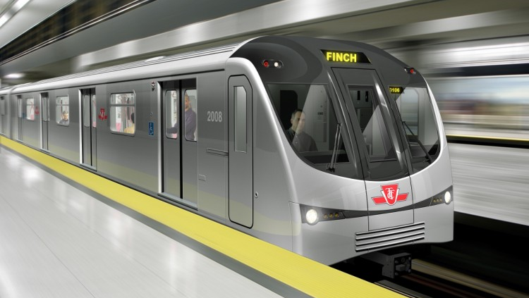
TTC Subway 2019 Delay Analysis
Ivy Fong
Jennifer Huynh
Nadia Iskandar
Shao/Jay Liu

Slide 2







Application Components
Cleaning Data
Database
Flask
Web
Dashboard Application
Source:
https://open.toronto.ca/
Wikipedia
Uploaded to PostgreSQL at Heroku with Pandas
Phyton Flask generate Json
https://ttc-2019-delays.herokuapp.com/
Multiple Raw Files to 2 Clean files

